Slide 1
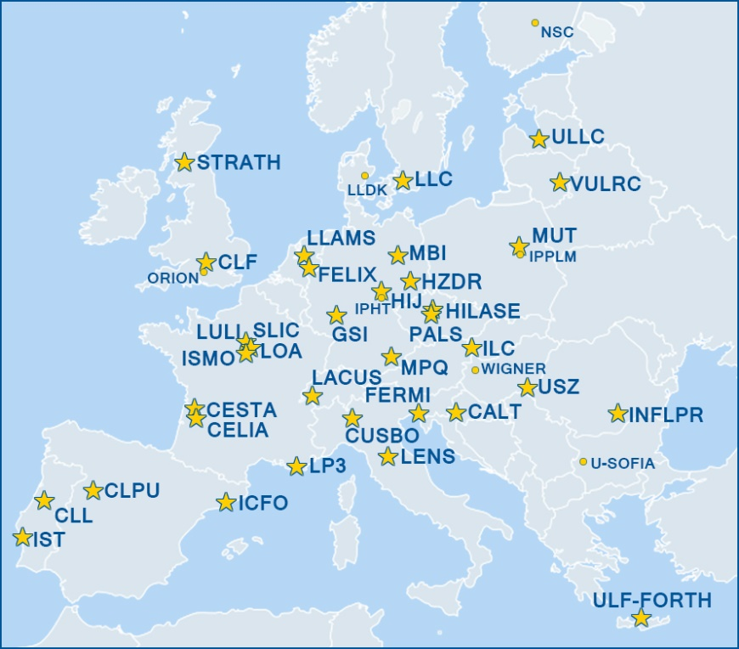
Your research needs lasers?
Laserlab-Europe The Integrated Initiative of European Laser Laboratories
Laserlab-Europe offers
access to 24 top-quality laser research facilities for scientists from all over the world to perform their own experiments
training and education opportunities for young researchers
regular webinars on research highlights from a broad range of laser-based science
Apply for access to one of the laser research facilities through www.laserlab-europe.eu/transnational-access

